Slide 1
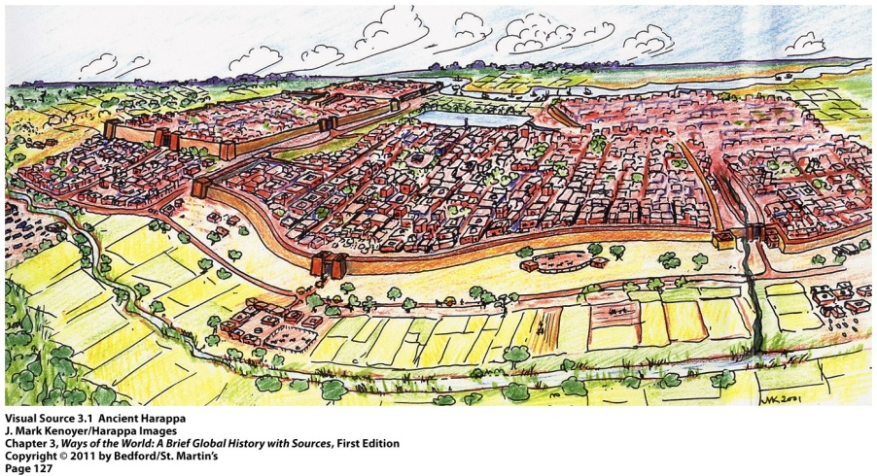
1. Simple farming using a hoe or digging stick rather than plows is known as ____________. a. strip farming b. natural farming c. pastoralism d. agriculture e. horticulture
2. The picture depicts the city
of Harappa is in the ________ River
Civilization.
a. Mesoamerica b. China c. Indus d. Andes
3. A central feature of ancient Mesopotamian cities was an enormous artificial hill, or _______________, topped by a temple.
a. ziggurat b. citadel c. stele d. acropolise
4. . Which First Civilization produced streets laid out in a grid-like pattern, with standardized houses, a complex sewage system, and grand public buildings including a public bath?
a. Norte Chico b. Sumer c. Egypt d. Indus Valley
5. Mohenjo-Daro and Harappa were sister cities in the ______ river civilization.
a. Norte Chico b. Chinese c. Mesoamerican d. Indus

Slide 2
1. Simple farming using a hoe or digging stick rather than plows is known as ____________. a. strip farming b. natural farming c. pastoralism d. agriculture e. horticulture
2. The picture depicts the city
of Harappa is in the ________ River
Civilization.
a. Mesoamerica b. China c. Indus d. Andes
3. A central feature of ancient Mesopotamian cities was an enormous artificial hill, or _______________, topped by a temple.
a. ziggurat b. citadel c. stele d. acropolise
4. . Which First Civilization produced streets laid out in a grid-like pattern, with standardized houses, a complex sewage system, and grand public buildings including a public bath?
a. Norte Chico b. Sumer c. Egypt d. Indus Valley
5. Mohenjo-Daro and Harappa were sister cities in the ______ river civilization.
a. Norte Chico b. Chinese c. Mesoamerican d. Indus

Slide 3
Using your textbook, technology of any kind to “do the map”

Slide 4
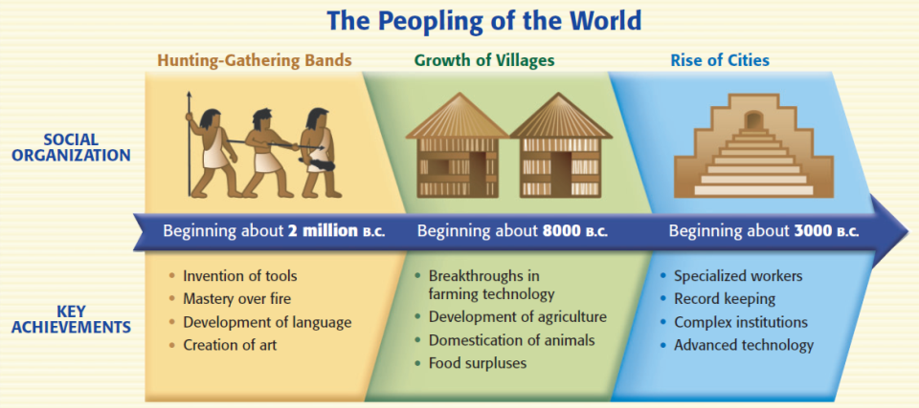
River Valley Civilizations
The discovery of farming during the Neolithic Revolution allowed nomadic people to settle into civilizations
Notes:
‹#›

Slide 5
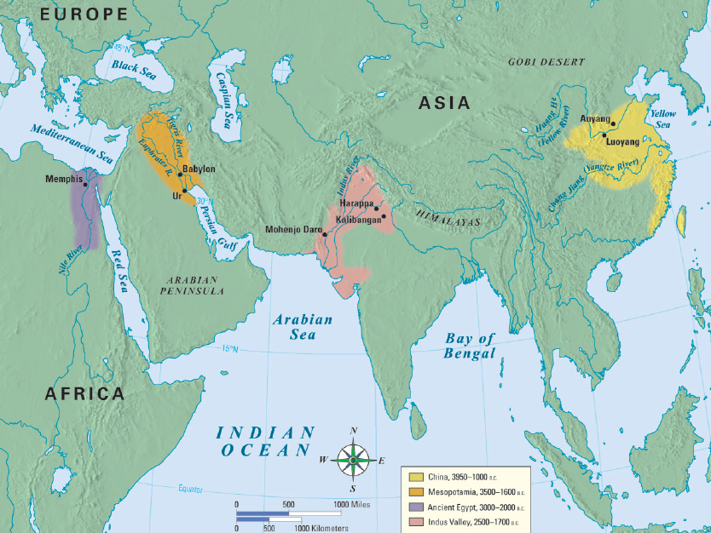
The world’s first civilizations all began in river valleys
The first civilization began in an area known as Mesopotamia
Notes:
‹#›

Slide 6
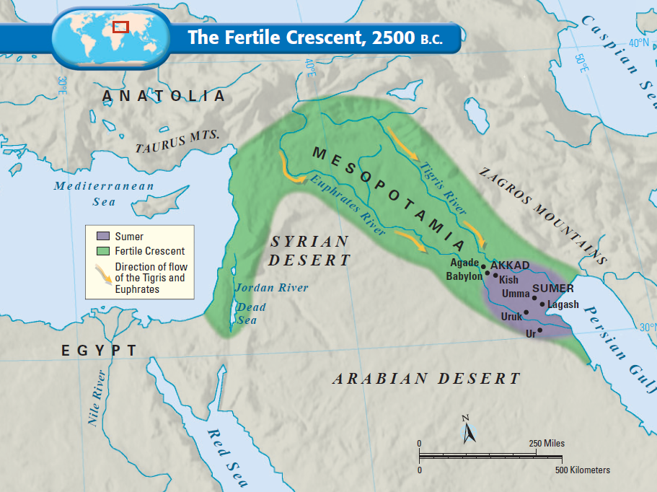
Mesopotamia means “land between the rivers” & is often called the “Fertile Crescent” or as the “Cradle of Civilization”
Notes:
‹#›

Slide 7
The first civilization developed in the Fertile Crescent: Sumer
But, surrounding deserts & the lack of natural barriers attracted outsiders to Mesopotamia made the Sumerians vulnerable to attack
Notes:
‹#›

Slide 8
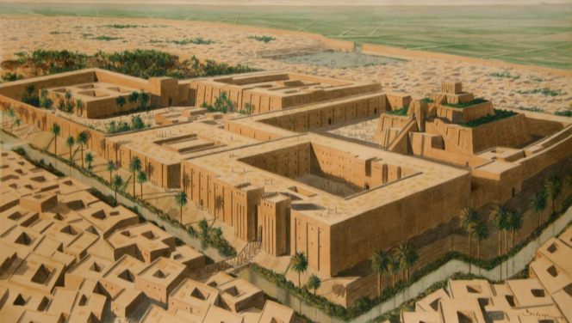
Lasting Contributions
Advanced cities:
Sumerian city-states were protected by high walls
At the city center was a temple called a ziggurat
Notes:
‹#›

Slide 9
Lasting Contributions
Specialized Workers:
At the top of society were priests, and then kings
In the middle were skilled workers, like merchants
At the bottom, were common farmers & slaves
Notes:
‹#›

Slide 10
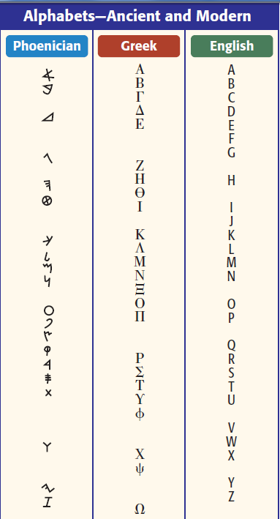
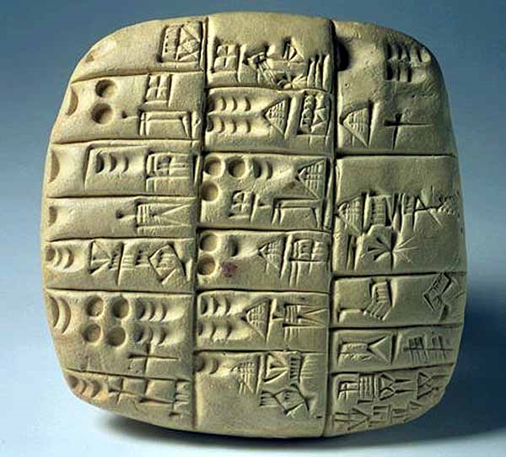
Lasting Contributions
Writing:
Sumerians made the world’s 1st writing called cuneiform
Phoenicians simplified cuneiform to a 22 letter alphabet
Phoenician merchants spread the alphabet throughout the Mediterranean world
The alphabet influenced Greek, Latin, & English
Notes:
‹#›

Slide 11
Lasting Contributions
Government:
Babylonian King Hammurabi created the first legal code
Hammurabi’s Code had 282 laws based on justice & retaliation (an eye for an eye)
The code had different punishments for the various levels of society
Notes:
‹#›

Slide 12
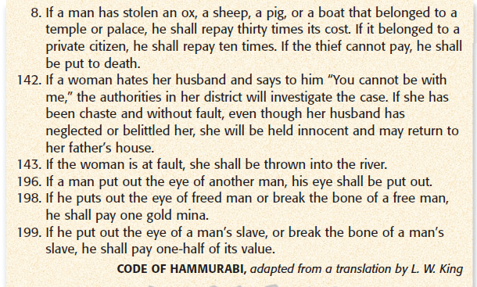
Code of Hammurabi
Notes:
‹#›

Slide 13
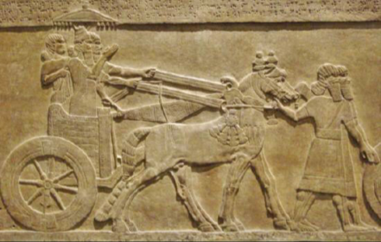
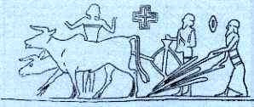
Lasting Contributions
Technology:
Sumerians inventions include the wheel, sail, plow, & bronze metalwork
Notes:
‹#›

