Slide 1
Essential Question for today:
What were the important characteristics of the civilizations in the Indus River Valley?
Warm-Up Question:
Name 2 similarities between Egypt & Mesopotamian civilizations
Name 2 differences

Slide 2
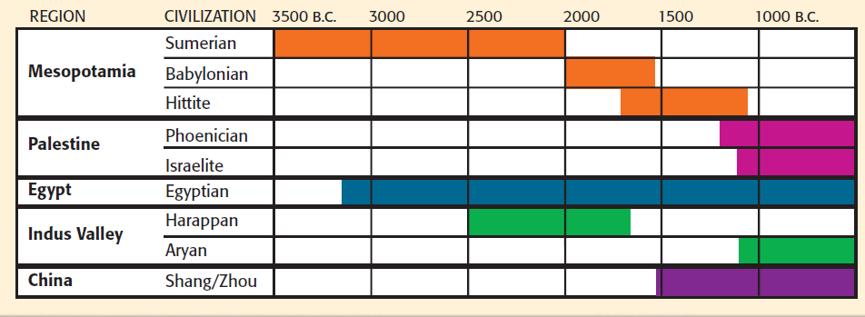

Slide 3
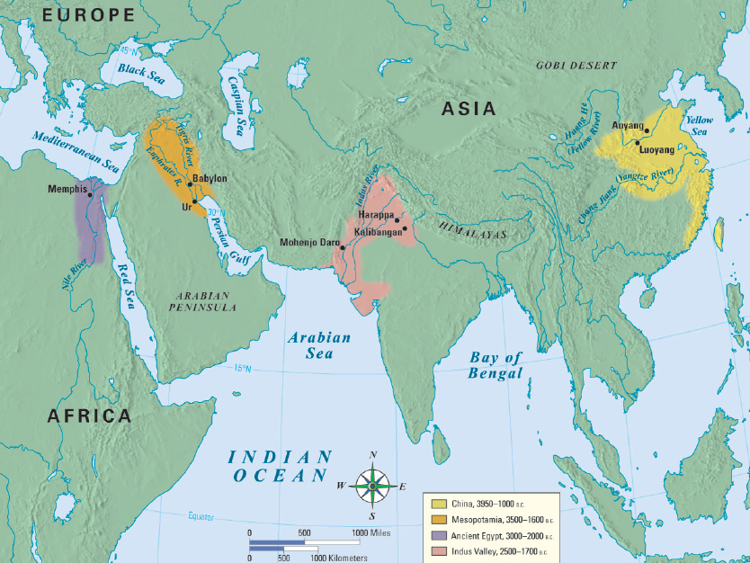
The Indus River Valley (India)
Notes:
3

Slide 4
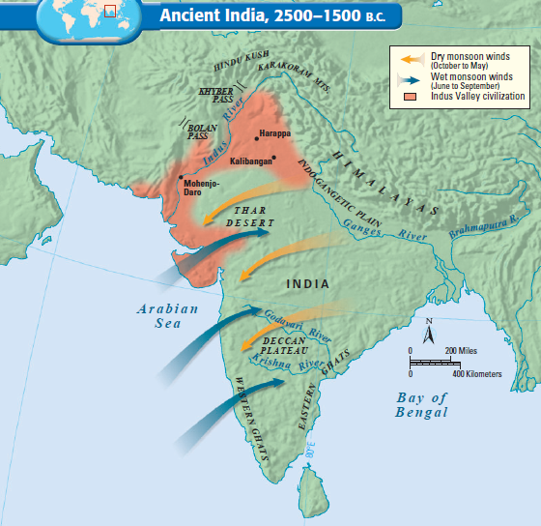
India began along the Indus River, which flooded & left behind fertile soil
Seasonal monsoons caused summer rains & floods
Notes:
4

Slide 5
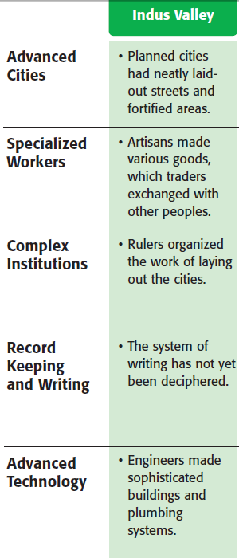
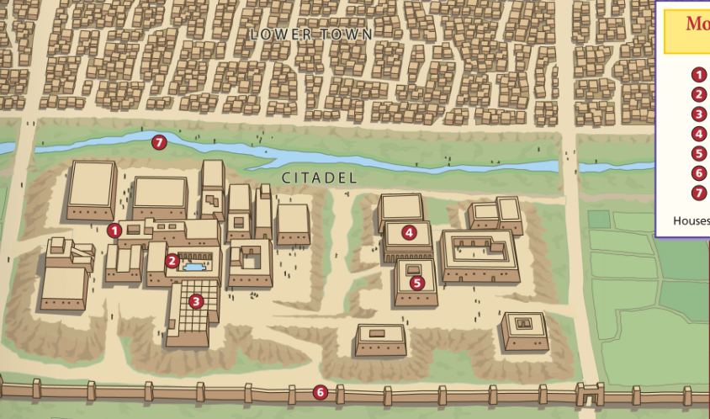
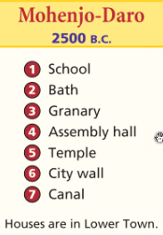
Lasting Contributions
Advanced cities:
Indus cities were laid out in a grid system with high walls & citadel of major buildings
Notes:
One of the most remarkable achievements of the Indus Valley people was their sophisticated city planning. The people of the Indus laid out their cities on a precise grid system. Cities featured a fortified area called a citadel, which contained the major buildings of the city. Buildings were constructed of oven-baked bricks cut in standard sizes, unlike the irregular mud bricks of the Mesopotamians. Early engineers also created sophisticated plumbing, sewage, and bath systems.
5

Slide 6
Religion:
Believed in a polytheistic religion called Hinduism
Hindus believe that one’s soul is reborn (reincarnated) until enlightenment (nirvana) is the spiritual release from human form
A soul’s karma (good or bad deeds) effect reincarnation
Notes:
The Upanishads are written as dialogues, or discussions, between a student and a teacher. In the course of the dialogues, the two explore how a person can achieve liberation from desires and suffering. This is described as moksha (MOHK•shah), a state of perfect understanding of all things. The teacher distinguishes between atman, the individual soul of a living being, and Brahman, the world soul that contains and unites all atmans.
When a person understands the relationship between atman and Brahman, that person achieves perfect understanding (moksha) and a release from life in this world. This understanding does not usually come in one lifetime. By the process of reincarnation (rebirth), an individual soul or spirit is born again and again until moksha is achieved. A soul’s karma—good or bad deeds—follows from one reincarnation to another. Karma influences specific life circumstances, such as the caste one is born into, one’s state of health, wealth or poverty, and so on.
6

Slide 7
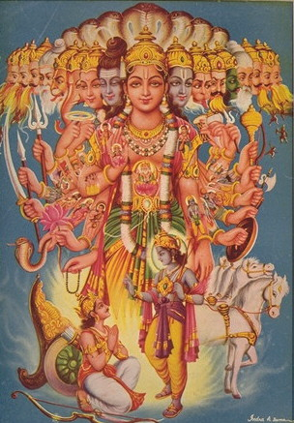
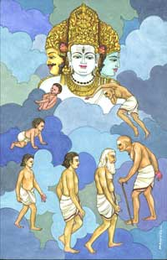
Notes:
7

Slide 8
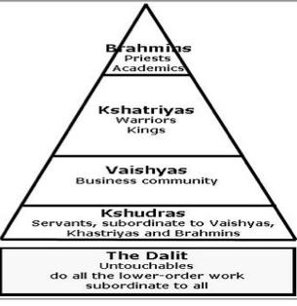
Caste System:
Strict social class based on birth and family
Occupation is without ?
*What your dad was, you are, no questions

Slide 9
Lasting Contributions
Writing:
Indus writing has not been fully translated
400 symbols that were pictograms characters
p. 101 has a great comparison chart of writings…let’s look at it!
Notes:
Unlike cuneiform and hieroglyphics, the writing of the Indus people has not been translated. Historians believe that Indus people used about 400 symbols in their language. Scientists believe the symbols, like hieroglyphs, are used both to depict an object and also as phonetic sounds. Some signs stand alone and others seem to be combined into words.
9

Slide 11
Lasting Contributions
Technology:
Advanced plumbing; Most houses had toilets & private bathrooms connected to underground sewer systems
Notes:
One of the most impressive technologies of the Indus people was their extensive and modern-looking plumbing systems. Almost every house in Indus cities had a private bathroom and toilet. The toilets were neatly built of brick with a wooden seat. Pipes connected to each house carried wastewater into an underground sewer system. No other civilization had such sophisticated plumbing until the 19th century. In addition, the Indus people built standard, oven-baked brinks, unlike the irregular mud bricks of the Mesopotamians.
11

Slide 12
China
Notes:
12

Slide 13
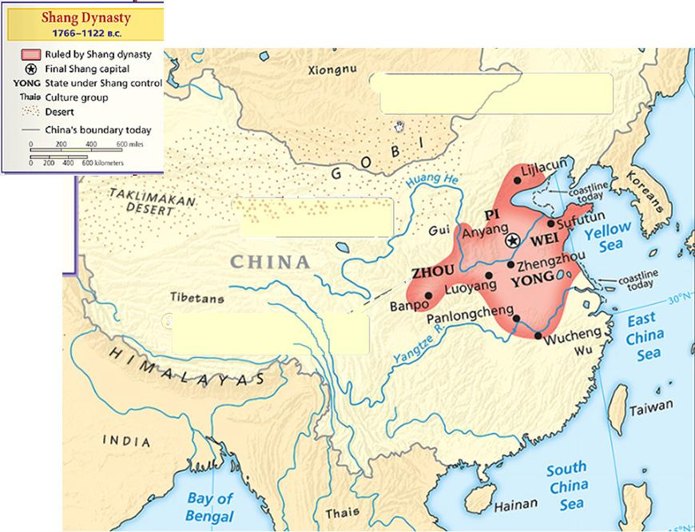
China began along the Yellow (Huang He) & Yangtze Rivers in the North China Plain; Only 10% of China is suitable for farming
The Yellow River flooding was unpredictable & was called “China’s Sorrow” because its floods often destroyed entire villages
Notes:
The Geography of China
Natural barriers somewhat isolated ancient China from all other civilizations. To China’s east lay the Yellow Sea, the East China Sea, and the Pacific Ocean. Mountain ranges and deserts dominate about two-thirds of China’s landmass. In west China lay the Taklimakan (TAH•kluh•muh•KAHN) Desert and the icy 15,000-foot Plateau of Tibet. To the southwest are the Himalayas. And to the north are the desolate Gobi Desert and the Mongolian Plateau.
River Systems Two major river systems flow from the mountainous west to the Pacific Ocean. The Huang He (hwahng•HUH), also known as the Yellow River, is found in the north. In central China, the Chang Jiang (chang•jyhang), also called Yangtze (yang•SEE), flows east to the Yellow Sea. The Huang He, whose name means “yellow river,” deposits huge amounts of yellowish silt when it overflows its banks. This silt is actually fertile soil called loess (LOH•uhs), which is blown by the winds from deserts to the west and north. Environmental Challenges Like the other ancient civilizations in this chapter, China’s first civilization developed in a river valley. China, too, faced the dangers of floods—but its geographic isolation posed its own challenges.
• The Huang He’s floods could be disastrous. Sometimes floods devoured whole villages, earning the river the nickname “China’s Sorrow.”
• Because of China’s relative geographic isolation, early settlers had to supply their own goods rather than trading with outside peoples.
• China’s natural boundaries did not completely protect these settlers from outsiders. Invasions from the west and north occurred again and again in Chinese history.
China’s Heartland Only about 10 percent of China’s land is suitable for farming. Much of the land lies within the small plain between the Huang He and the Chang Jiang in eastern China. This plain, known as the North China Plain, is China’s heartland. Throughout China’s long history, its political boundaries have expanded and contracted depending on the strength or weakness of its ruling families. Yet the heartland of China remained the center of its civilization.
13

Slide 14
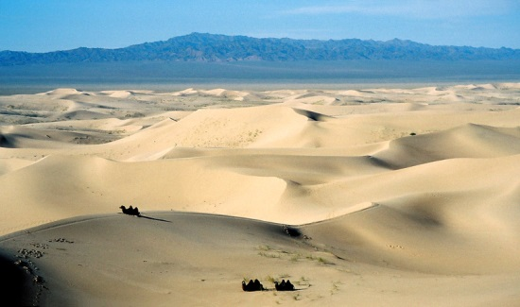
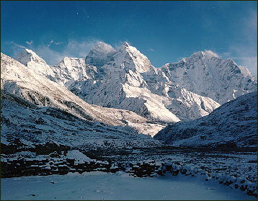
China was protected & isolated from outsiders by deserts & the Himalayan Mountains
The Chinese referred to themselves as the “Middle Kingdom” & rarely traded with outsiders
Notes:
The Geography of China
Natural barriers somewhat isolated ancient China from all other civilizations. To China’s east lay the Yellow Sea, the East China Sea, and the Pacific Ocean. Mountain ranges and deserts dominate about two-thirds of China’s landmass. In west China lay the Taklimakan (TAH•kluh•muh•KAHN) Desert and the icy 15,000-foot Plateau of Tibet. To the southwest are the Himalayas. And to the north are the desolate Gobi Desert and the Mongolian Plateau.
River Systems Two major river systems flow from the mountainous west to the Pacific Ocean. The Huang He (hwahng•HUH), also known as the Yellow River, is found in the north. In central China, the Chang Jiang (chang•jyhang), also called Yangtze (yang•SEE), flows east to the Yellow Sea. The Huang He, whose name means “yellow river,” deposits huge amounts of yellowish silt when it overflows its banks. This silt is actually fertile soil called loess (LOH•uhs), which is blown by the winds from deserts to the west and north. Environmental Challenges Like the other ancient civilizations in this chapter, China’s first civilization developed in a river valley. China, too, faced the dangers of floods—but its geographic isolation posed its own challenges.
• The Huang He’s floods could be disastrous. Sometimes floods devoured whole villages, earning the river the nickname “China’s Sorrow.”
• Because of China’s relative geographic isolation, early settlers had to supply their own goods rather than trading with outside peoples.
• China’s natural boundaries did not completely protect these settlers from outsiders. Invasions from the west and north occurred again and again in Chinese history.
China’s Heartland Only about 10 percent of China’s land is suitable for farming. Much of the land lies within the small plain between the Huang He and the Chang Jiang in eastern China. This plain, known as the North China Plain, is China’s heartland. Throughout China’s long history, its political boundaries have expanded and contracted depending on the strength or weakness of its ruling families. Yet the heartland of China remained the center of its civilization.
14

Slide 15
Lasting Contributions
Advanced Cities:
had high walls for protection
But, Chinese buildings were made of wood rather than brick or stone
Notes:
Early Cities Among the oldest and most important Shang cities was Anyang (ahn•YAHNG), one of the capitals of the Shang Dynasty. Unlike the cities of the Indus Valley or Fertile Crescent, Anyang was built mainly of wood. The city stood in a forest clearing. The higher classes lived in timber-framed houses with walls of clay and straw. These houses lay inside the city walls. The peasants and craftspeople lived in huts outside the city. The Shang surrounded their cities with massive earthen walls for protection. The archaeological remains of one city include a wall of packed earth 118 feet wide at its base that encircled an area of 1.2 square miles. It likely took 10,000 men more than 12 years to build such a structure. Like the pyramids of Egypt or the cities of the Indus Valley, these walls demonstrate the Shang rulers’ ability to raise and control large forces of workers. Shang peoples needed walled cities because they were constantly waging war. The chariot, one of the major tools of war, was probably first introduced by contact with cultures from western Asia. Professional warriors underwent lengthy training to learn the techniques of driving and shooting from horse-drawn chariots.
15

Slide 16
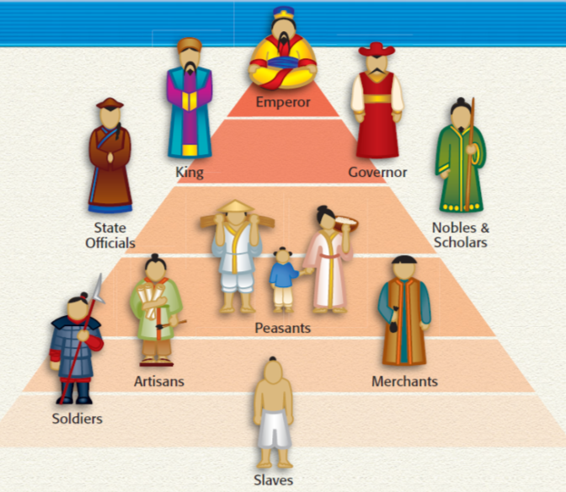
Lasting Contributions
Unlike other river valley civilizations, the Chinese held peasants higher than artisans or merchants because they produced food
Specialized Workers:
?
Notes:
Family The family was central to Chinese society. The most important virtue was respect for one’s parents. The elder men in the family controlled he family’s property and made important decisions. Women, on the other hand, were treated as inferiors. They were expected to obey their fathers, their husbands, and later, their own sons. When a girl was between 13 and 16 years old, her marriage was arranged, and she moved into the house of her husband. Only by bearing sons for her husband’s family could she hope to improve her status.
Social Classes Shang society was sharply divided between nobles and peasants. A ruling class of warrior-nobles headed by a king governed the Shang. These noble families owned the land. They governed the scattered villages within the Shang lands and sent tribute to the Shang ruler in exchange for local control. Under the Han Dynasty, the structure of Chinese society was clearly defined. At the top was the emperor, who was considered semi-divine. Next came kings and governors, both appointed by the emperor. They governed with the help of state officials, nobles, and scholars. Peasant farmers came next. Their production of food was considered vital to the existence of the empire. Artisans and merchants were below them. Near the bottom were the soldiers, who guarded the empire’s frontiers. At the bottom were enslaved persons, who were usually conquered peoples.
Control Through Feudalism The Zhou Dynasty controlled lands that stretched far beyond the Huang He in the north to the Chang Jiang in the south. To govern this vast area, it gave control over different regions to members of the royal family and other trusted nobles. This established a system called feudalism. Feudalism is a political system in which nobles, or lords, are granted the use of lands that legally belong to the king. In return, the nobles owe loyalty and military service to the king and protection to the people who live on their estates. Similar systems would arise centuries later in both Japan and Europe. At first, the local lords lived in small walled towns and had to submit to the superior strength and control of the Zhou rulers. Gradually, however, the lords grew stronger as the towns grew into cities and expanded into the surrounding territory. Peoples who had been hostile toward the lords gradually accepted their rule and adopted Zhou ways. As a result, the local lords became less dependent on the king. More and more, they fought among themselves and with neighboring peoples for wealth and territory.
16

Slide 17
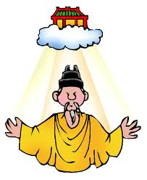
Lasting Contributions
Government:
Like Egypt, China was ruled by families called dynasties
Ruler’s justified their power by claiming Mandate of Heaven (approval of the gods)
Notes:
To justify their conquest, the Zhou leaders declared that the final Shang king had been such a poor ruler that the gods had taken away the Shang’s rule and given it to the Zhou. This justification developed over time into a broader view that royal authority came from heaven. A just ruler had divine approval, known as the Mandate of Heaven. A wicked or foolish king could lose the Mandate of Heaven and so lose the right to rule. The Mandate of Heaven became central to the Chinese view of government. Floods, riots, and other calamities might be signs that the ancestral spirits were displeased with a king’s rule. In that case, the Mandate of Heaven might pass to another noble family. This was the Chinese explanation for rebellion, civil war, and the rise of a new dynasty. Historians describe the pattern of rise, decline, and replacement of dynasties as the dynastic cycle, shown above.
17

Slide 18
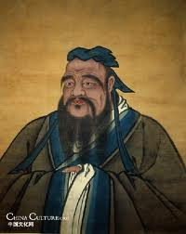
Lasting Contributions
Government:
China was also ruled by the ethical system, Confucianism
Confucianism focused on filial piety (respect for elders)
Confucius taught social order
*Respect for parents/elders
*Education is important
Notes:
Confucius and the Social Order
Toward the end of the Zhou Dynasty, China moved away from its ancient values of social order, harmony, and respect for authority. Chinese scholars and philosophers developed different solutions to restore these values.
Confucius Urges Harmony China’s most influential scholar was Confucius
(kuhn•FYOO•shuhs). Born in 551 B.C., Confucius lived in a time when the Zhou Dynasty was in decline. He led a scholarly life, studying and teaching history, music, and moral character. Confucius was born at a time of crisis and violence in China. He had a deep desire to restore the order and moral living of earlier times to his society. Confucius believed that social order, harmony, and good government could be restored in China if society were organized around five basic relationships. These were the relationships between: 1) ruler and subject, 2) father and son, 3) husband and wife, 4) older brother and younger brother, and 5) friend and friend. A code of proper conduct regulated each of these relationships. For example, rulers should practice kindness and virtuous living. In return, subjects
should be loyal and law-abiding. Three of Confucius’s five relationships were based upon the family. Confucius stressed that children should practice filial piety, or respect for their parents and ancestors. Filial piety, according to Confucius, meant devoting oneself to one’s parents during their lifetime. It also required honoring their memory after death through the performance of certain rituals. Confucius wanted to reform Chinese society by showing rulers how to govern wisely. Impressed by Confucius’s wisdom, the duke of Lu appointed him minister of justice. According to legend, Confucius so overwhelmed people by his kindness and courtesy that almost overnight, crime vanished from Lu.
When the duke’s ways changed, however, Confucius became disillusioned and resigned. Confucius spent the remainder of his life teaching. His students later collected his words in a book called the Analects. A disciple named Mencius (MEHN•shee•uhs) also spread Confucius’s ideas.
Confucian Ideas About Government Confucius said that education could transform a humbly born person into a gentleman. In saying this, he laid the groundwork for the creation of a bureaucracy, a trained civil service, or those who run the government. According to Confucius, a gentleman had four virtues: “In his private conduct he was courteous, in serving his master he was punctilious [precise], in providing for the needs of the people he gave them even more than their due; in exacting service from the people, he was just.” Education became critically important to career advancement in the bureaucracy. Confucianism was never a religion, but it was an ethical system, a system based on accepted principles of right and wrong. It became the foundation for Chinese government and social order. In addition, the ideas of Confucius spread beyond China and influenced civilizations throughout East Asia.
Other Ethical Systems In addition to Confucius, other Chinese scholars and philosophers developed ethical systems with very different philosophies. Some stressed the importance of nature, others, the power of government. Daoists Seek Harmony For a Chinese thinker named Laozi (low•dzuh), who may have lived during the sixth century B.C., only the natural order was important. The natural order involves relations among all living things. His book Dao De Jing (The Way of Virtue) expressed Laozi’s belief. He said that a universal force called the Dao (dow), meaning “the Way,” guides all things. Of all the creatures of nature, according to Laozi, only humans fail to follow the Dao. They argue about questions of right and wrong, good manners or bad. According to Laozi, such arguments are
pointless. The philosophy of Laozi came to be known as Daoism. Its search for knowledge and understanding of nature led Daoism’s followers to pursue scientific studies.
Daoists made many important contributions to the sciences of alchemy, astronomy, and medicine.
Legalists Urge Harsh Rule In sharp contrast to the followers of Confucius and Laozi was a group of practical political thinkers called the Legalists. They believed that a highly efficient and powerful government was the key to restoring order in society. They got their name from their belief that government should use the law to end civil disorder and restore harmony. Hanfeizi and Li Si were among the founders of Legalism. The Legalists taught that a ruler should provide rich rewards for people who carried
out their duties well. Likewise, the disobedient should be harshly punished. In practice, the Legalists stressed punishment more than rewards. For example, anyone
caught outside his own village without a travel permit should have his ears or nose chopped off. The Legalists believed in controlling ideas as well as actions. They suggested that a ruler burn all writings that might encourage people to criticize government. After all, it was for the prince to govern and the people to obey. Eventually, Legalist ideas gained favor with a prince of a new dynasty that replaced the Zhou. That powerful ruler soon brought order to China. I Ching and Yin and Yang People with little interest in the philosophical debates of the Confucians, Daoists, and Legalists found answers to life’s questions elsewhere. Some consulted a book of oracles called I Ching (also spelled Yi Jing) to solve ethical or practical problems. Readers used the book by throwing a set of coins, interpreting the results, and then reading the appropriate oracle, or prediction. The I Ching (The Book of Changes) helped people to lead a happy life by offering good advice and simple common sense. Other people turned to the ideas of ancient thinkers, such as the concept of yin and yang—two powers that together represented the natural rhythms of life. Yin represents all that is cold, dark, soft, and mysterious. Yang is the opposite—warm, bright, hard, and clear. The symbol of yin and yang is a circle divided into halves, as shown in the emblem to the upper right. The circle represents the harmony of yin and yang. Both forces represent the rhythm of the universe and complement
each other. Both the I Ching and yin and yang helped Chinese people understand how they fit into the world.
18

Slide 19
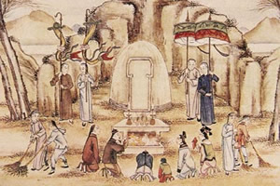
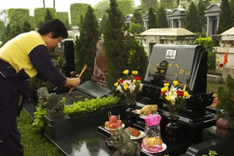
Lasting Contributions
Religion:
Chinese believed in ancestor worship, that the spirits of family ancestors should be honored & consulted
Notes:
Religious Beliefs In China, the family was closely linked to religion. The Chinese believed that the spirits of family ancestors had the power to bring good fortune or disaster to living members of the family. The Chinese did not regard these spirits as mighty gods. Rather, the spirits were more like troublesome or helpful neighbors who demanded attention and respect. Every family paid respect to the father’s ancestors and made sacrifices in their honor. Through the spirits of the ancestors, the Shang consulted the gods. The Shang worshiped a supreme god, Shang Di, as well as many lesser gods. Shang kings consulted the gods through the use of oracle bones, animal bones and tortoise shells on which priests had scratched questions for the gods. After inscribing a question on the bone, a priest applied a hot poker to it, which caused it to crack. The priests then interpreted the cracks to see how the gods had answered.
19

Slide 20
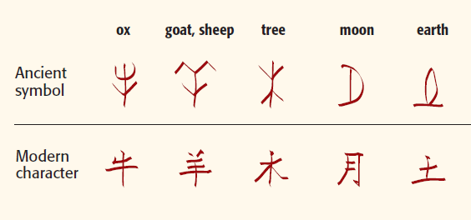
Lasting Contributions
Writing:
Like hieroglyphics, Chinese characters stood for sounds but the 10,000 characters made it hard to learn to write
Notes:
In the Chinese method of writing, each character generally stands for one syllable or unit of language. Recall that many of the Egyptian hieroglyphs stood for sounds in the spoken language. In contrast, there were practically no links between China’s spoken language and its written language. One could read Chinese without being able to speak a word of it. (This seems less strange when you think of our own number system. Both a French person and an American can understand the written equation 2 + 2 = 4. But an American may not understand the spoken statement “Deux et deux font quatre.”) The Chinese system of writing had one major advantage. People in all parts of China could learn the same system of writing, even if their spoken languages were very different. Thus, the Chinese written language helped unify a large and diverse land, and made control much easier. The disadvantage of the Chinese system was the enormous number of written characters to be memorized—a different one for each unit of language. A person
needed to know over 1,500 characters to be barely literate. To be a true scholar, one needed to know at least 10,000 characters. For centuries, this severely limited the number of literate, educated Chinese. As a general rule, a nobleperson’s children learned to write, but peasant children did not.
20

Slide 21
Lasting Contributions
Technology:
Cast iron tools & weapons
Standardized coins
Notes:
The Zhou Dynasty produced many innovations.
• Roads and canals were built to stimulate trade and agriculture.
• Coined money was introduced, which further improved trade.
• Blast furnaces that produced cast iron were developed.
Zhou cast iron production would not be matched in Europe until the Middle Ages. The Zhou used iron to create weapons, especially dagger-axes and swords. They also used it for common agricultural tools such as sickles, knives, and spades. Iron tools made farm work easier and more productive. The ability to grow more food helped Zhou farmers support thriving cities.
A Program of Centralization Shi Huangdi’s sweeping program of centralization
included the building of a highway network of more than 4,000 miles. Also, he set the same standards throughout China for writing, law, currency, and weights and measures—even down to the length of cart axles. This last standard made sure that all vehicles could fit into the ruts of China’s main roads.
Under Shi Huangdi’s rule, irrigation projects increased farm production. Trade blossomed, thanks to the new road system. Trade pushed a new class of merchants into prominence. Despite these social advances, harsh taxes and repressive government made the Qin regime unpopular. Shi Huangdi had unified China at the expense of human freedom.
Great Wall of China Scholars hated Shi Huangdi for his book burning. Poor people hated him because they were forced to work on the building of a huge defensive wall. Earlier, Zhou rulers had erected smaller walls to discourage attacks by northern nomads. Shi Huangdi determined to close the gaps and extend the wall almost the length of the empire’s border. Enemies would have to gallop halfway to Tibet to get around it. The Great Wall of China arose on the backs of hundreds of thousands of peasants. The wall builders worked neither for wages nor for love of empire. They faced a terrible choice: work on the wall or die. Many of the laborers worked on the wall and died anyway, victims of the crushing labor or the harsh winter weather.
21

Slide 22
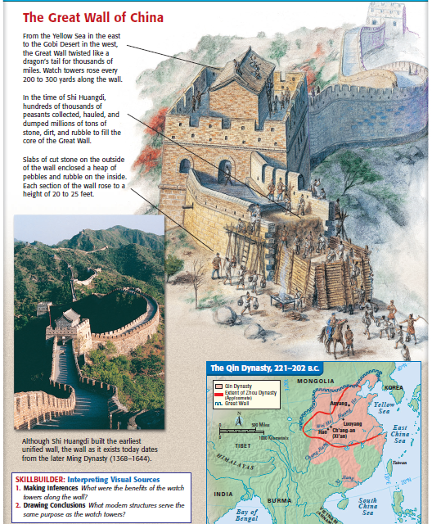
The Great Wall was built to protect China from invasions from the North
Notes:
22

