Slide 1
Essential Question:
What were the important characteristics of ancient Egypt?
Warm-Up Question:
Create a “Hammurabi’s Code” for East View High School. Think of 5 laws & punishments appropriate for school.

Slide 2
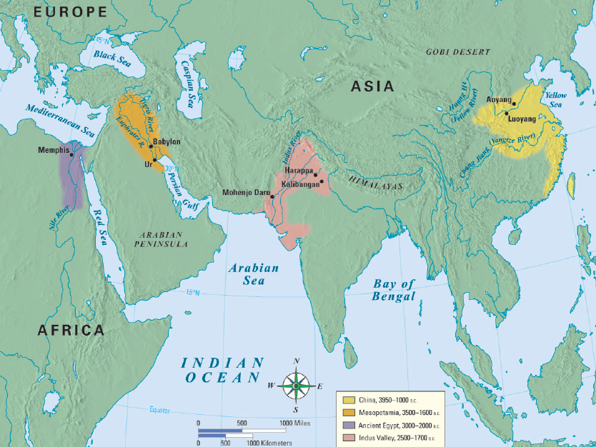
Ancient Egypt
Class Activity: Examine the placards provided & generate 3 conclusions about the geography of ancient Egypt & its impact on the people of this region
Notes:
‹#›

Slide 3
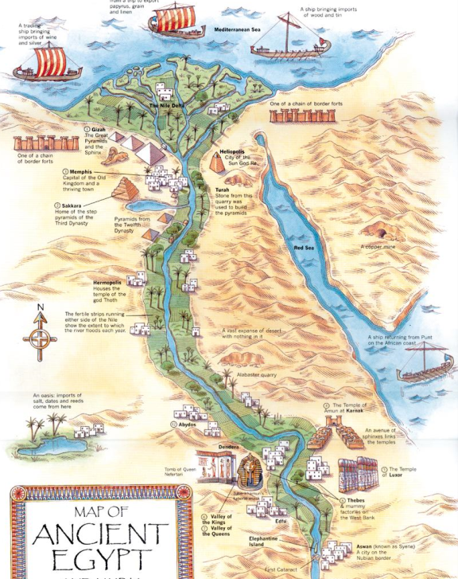
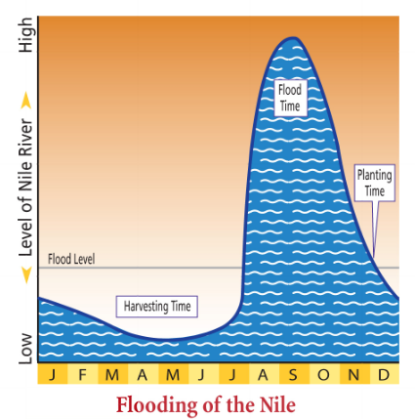
Egypt began along the Nile River in North Africa
Egypt was bordered on both sides by desert which isolated & protected Egyptians from outsiders
The Nile River’s annual floods were predictable & provided fertile soil for farming
The Nile flooded so predictably that the Egyptians designed their calendar around it
Notes:
The Geography of Egypt
From the highlands of East Africa to the Mediterranean Sea, the Nile River flows northward across Africa for over 4,100 miles, making it the longest river in the world. A thin ribbon of water in a parched desert land, the great river brings its water to Egypt from distant mountains, plateaus, and lakes in present-day Burundi, Tanzania, Uganda, and Ethiopia. Egypt’s settlements arose along the Nile on a narrow strip of land made fertile by the river. The change from fertile soil to desert—from the Black Land to the Red Land—was so abrupt that a person could stand with one foot in each.
The Gift of the Nile As in Mesopotamia, yearly flooding brought the water and rich soil that allowed settlements to grow. Every year in July, rains and melting snow from the mountains of east Africa caused the Nile River to rise and spill over its banks. When the river receded in October, it left behind a rich deposit of fertile black mud called silt. Before the scorching sun could dry out the soil, the peasants would prepare their wheat and barley fields. All fall and winter they watered their crops from a network of irrigation ditches. In an otherwise parched land, the abundance brought by the Nile was so great that the Egyptians worshiped it as a god who gave life and seldom turned against them. As the ancient Greek historian Herodotus remarked in the fifth century B.C., Egypt was the “gift of the Nile.”
‹#›

Slide 4
What were the important characteristics of the Egyptian civilization?
Working in groups, examine each of the 6 placards examining the characteristics of civilization in Egypt
For each placard, write hypotheses about government, cities, technology, etc. & then confirm your theories by locating the matching “answer key” placard around the room

Slide 5
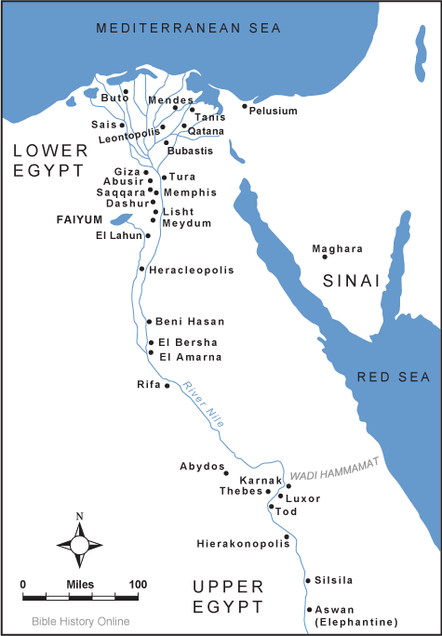
Lasting Contributions
Advanced Cities:
Cities developed along the Nile River in “Upper Egypt” & “Lower Egypt”
Notes:
‹#›

Slide 6
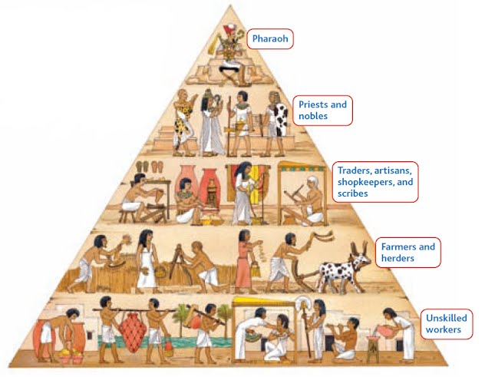
Lasting Contributions
Specialized Workers:
?
Notes:
‹#›

Slide 7
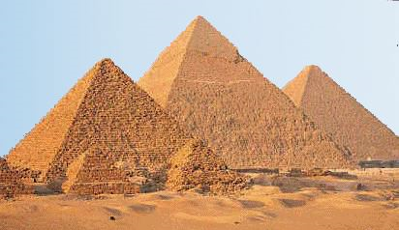
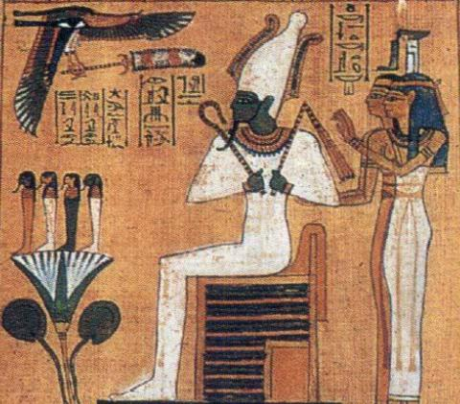
Lasting Contributions
Government :
Pharaohs ruled Egypt as “king-gods” & were thought to control nature
Egyptians constructed pyramids & elaborate tombs for the pharoahs
Notes:
‹#›

Slide 8
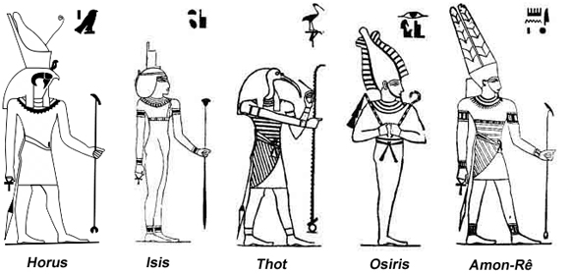
Lasting Contributions
Religion:
Egyptians were polytheistic & believed the gods controlled all aspects of life
Notes:
‹#›

Slide 9
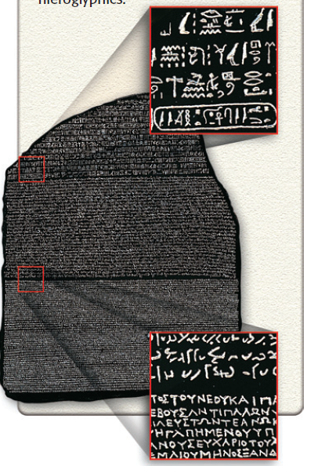
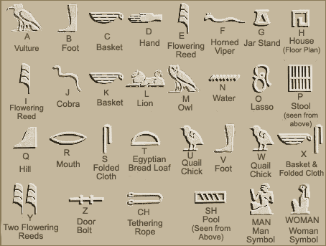
Lasting Contributions
Writing:
Egyptian hieroglyphics was both pictograms & a phonetic alphabet
Hieroglyphics were translated using the Rosetta Stone
Notes:
‹#›

Slide 10
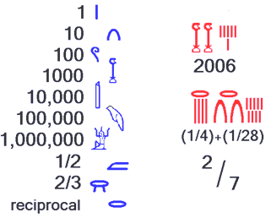
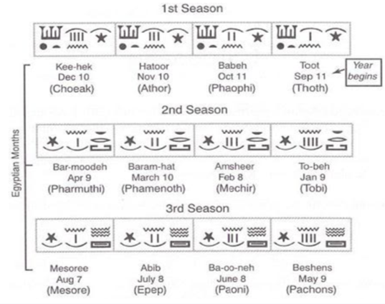
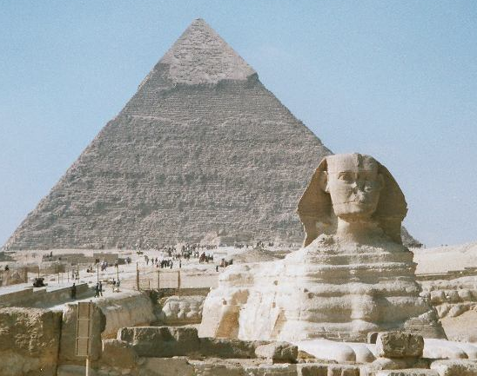
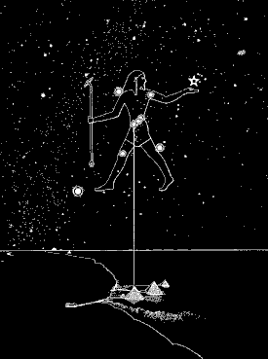
Lasting Contributions
Technology:
Egyptian ideas included a 365-day calendar, geometry, astronomy, & pyramids
Notes:
‹#›

