Slide 1
Take out Ch 2 Study Guide and Purple “Key Concepts” sheet
Test tomorrow-bring a pencil
Ways of the World study online
Civilization
Visual of three systems (Pastoralists, Villages, Chiefdoms)
Why would these differences emerge?
Change over time with purple sheet
The Plow-James Burke

Slide 2
Let’s watch a video…
Hitler's reaction to his score on the AP test

Slide 3
An example of a question tomorrow
Early agricultural people:
uniformly enjoyed a greater life expectancy than gathering and hunting peoples.
did not suffer from famines.
sometimes suffered from deadly diseases caught from domesticated animals.
had more leisure time than their gathering and hunting counterparts.
were only able to support smaller populations than their gathering and hunting counterparts.

Slide 4
Neolithic Revolution/ Agricultural revolution

Slide 5
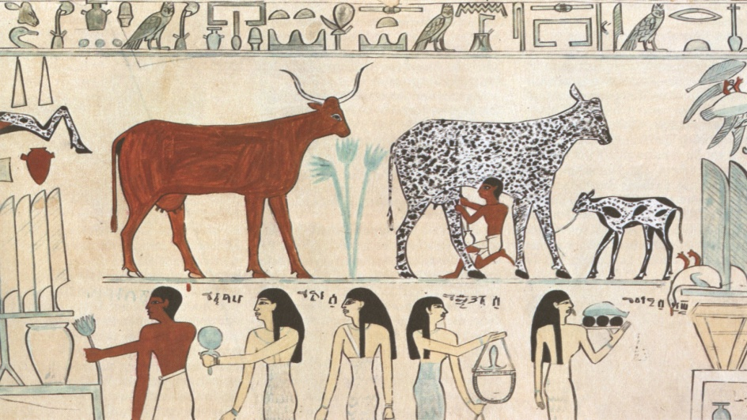
Neolithic
“New Stone” Age
Domesticated Animals
Farming led to:
Surplus
Settled way of life
Cultural achievements
Rise of city-states
Civilization

Slide 6
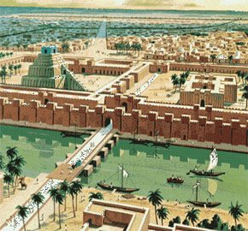
Surplus
Food storage-grain for mass numbers of population
River valleys: agriculture required a stable source of water

Slide 7
Urban Centers (Cities)
River valleys: agriculture required a stable source of water

Slide 8
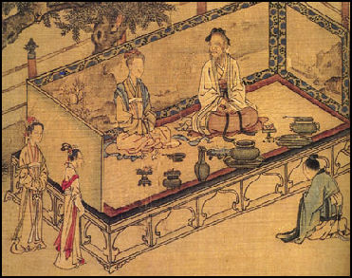
Specialization
Specialization brought expertise
Artisans – skilled craft workers who made pottery or woven goods

Slide 9
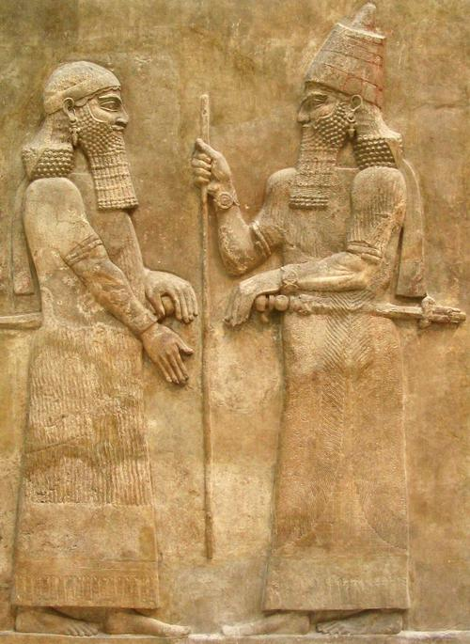
Government
Issues laws, collects taxes, organizes defense, monitors/rations food supply
Bureaucracy – managing government through departments of officials
Protecting the surplus was of the utmost importance

Slide 10
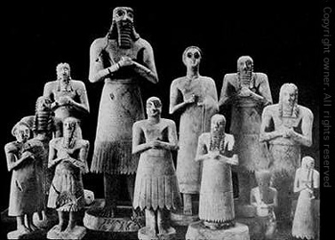
Religion
People believed in higher beings
Polytheistic – many gods
People wanted to gain favor with the gods

Slide 11
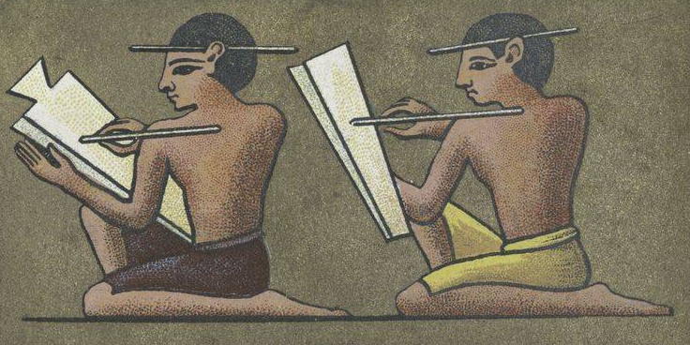
Complex Writing
Crucial skill for early civilizations
Economic records (floods, crop yields)
Pictograms – simple drawings to show words
Scribes – as writing became complex these trained experts learned to read and write

Slide 12
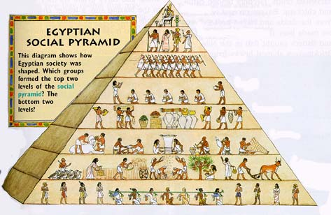
Social Classes
People were ranked according to their jobs/occupations
Priests and nobles were at the top level of society
Next, came merchants, artisans, peasant farmers, and finally…..slaves.

Slide 13
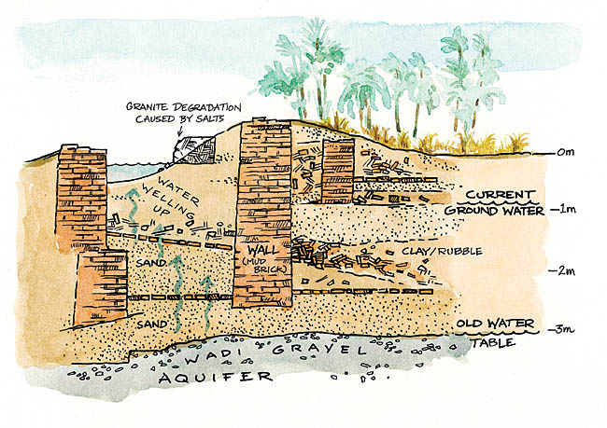
Public Works
Monumental architecture – temples, palaces
Irrigation systems, roads and bridges
Defensive walls
Sewage system
Education

Slide 14
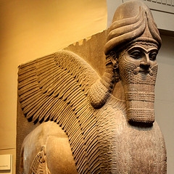
Eight Components of Civilization: 8. Art and Architecture
Expressed the beliefs and values of people who created them
Temples and palaces reassured people of the strength and power of their government and religion

Slide 15
Neolithic Age-New Technologies
Calendar to keep track of planting and harvesting
Simple metal tools such
as plows
Used animals to pull plows
Metal weapons developed as villages needed to protect their valuable resources.

Slide 16
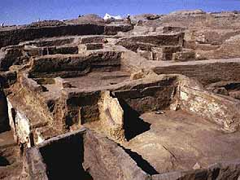
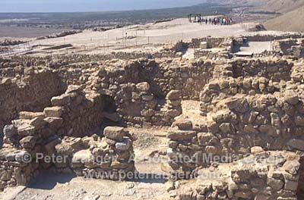
The Neolithic Revolution
First Towns Develop
Catal Huyuk
Modern Turkey
First settled:
c. 7000BCE
Jericho
Modern Israel
First settled:
c. 7000BCE

Slide 17
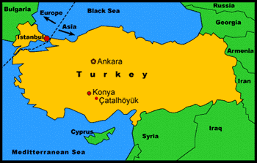
Catal Huyuk - Çatalhöyük
Remains of a Neolithic town
9,000 years ago, one of the world's largest settlements.

Slide 18
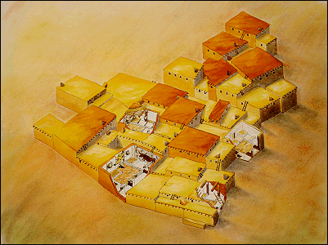
Catal Huyuk
Çatal Hüyük, Southern Anatolia, Turkey - Neolithic, from 6500 up to 5700 years BCE

Slide 19
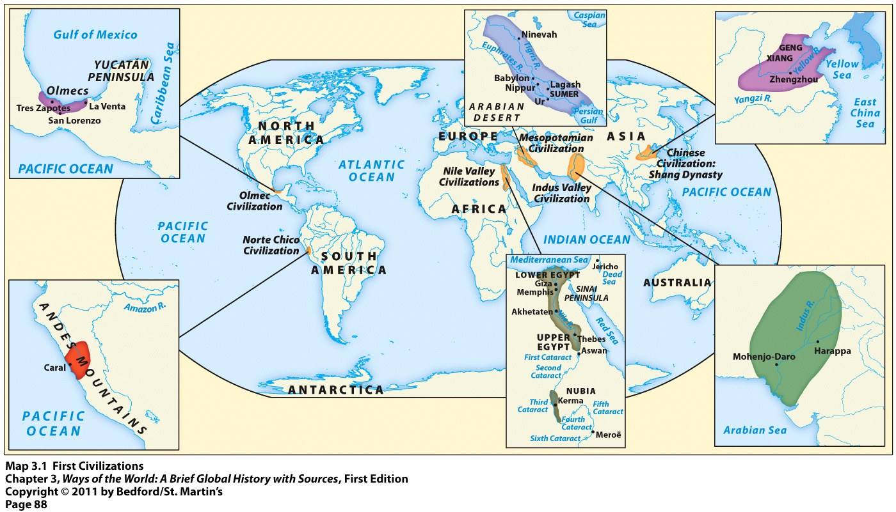
Emergence of Civilizations

Slide 20
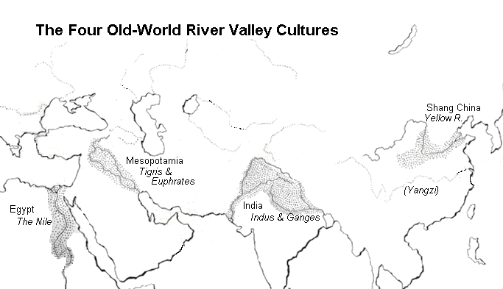
Four Early River Valleys

Slide 21
How did they become civilizations?
Neolithic Revolution – domestication of plants & animals
Organized Farming & village life
Food Surplus was created led to specialization of labor
Growth in population
Creation of complex socieites requiring complex institutions which governed large scale projects like irrigation

Slide 22
The Neolithic Revolution
Metal Working: From Copper to Bronze
The working of metals became very important to early human settlements for tools & weapons.
Early settlements gradually shifted from copper to the stronger alloy bronze by 3,000BCE—ushers in the Bronze Age!
Metal working spread throughout human communities slowly as agriculture had.

Slide 23
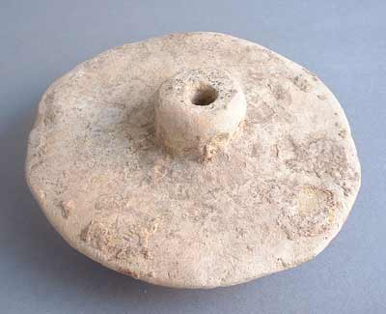
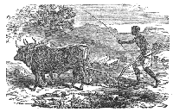
The Neolithic Revolution
Further Technological Advancements
 | Wheeled Vehicles Saves labor, allows transport of large loads and enhances trade
 | Potters Wheel (c.6000BCE) Allows the construction of more durable clay vessels and artwork
 | Irrigation & Driven Plows Allows further increase of food production, encourages pop. growth

Slide 24
The Neolithic Revolution
Early Human Impact on the Environment
Deforestation in places where copper, bronze, and salt were produced.
Erosion and flooding where agriculture disturbed soil and natural vegetation.
Selective extinction of large land animals and weed plants due to hunting & agriculture.

Slide 25
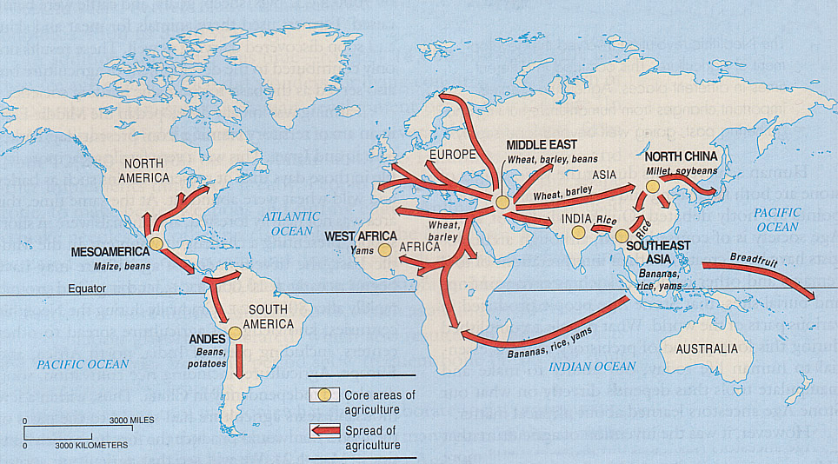
The Neolithic Revolution
Agriculture Slowly Spreads: What do you notice about the core areas?

